Slide 1

Predicting Heart Disease Risk: Analyzing Health and Socio-Economic Indicators Aisha Mohammad

Slide 2

Contents:
Define subject.
Problem statement
Stakeholder needs
Data Justification
High architecture diagram
MVP
Methodology

Slide 3
Defining the Subject Heart disease remains one of the leading global health challenges, with its prevalence steadily increasing. Studies highlight that individuals with diabetes are significantly more prone to developing cardiovascular conditions compared to those without diabetes. Alongside clinical indicators like physical activity and cholesterol levels, socioeconomic factors such as income, education, race, and gender also play a crucial role in influencing heart disease risk. This analysis project examines the intersection of health and socioeconomic factors, providing insights into the predictors of heart disease and identifying vulnerable groups. The findings aim to support informed decision-making and promote equitable healthcare strategies..

Slide 4

Problem statement
Heart disease remains a leading global health concern, however, the impact of socioeconomic factors like income, education, race, and gender on heart disease risk is often underexplored.
This project aims to conduct an in-depth analysis and prediction of heart disease risk by examining both clinical health indicators and socioeconomic determinants. By identifying key patterns, disparities, and correlations, the project will not only provide insights into the underlying factors contributing to heart disease but also develop predictive models to identify individuals at risk.
These findings will help inform public health strategies, optimize resource allocation, and address health inequities in heart disease prevention and management.

Slide 5
stakeholder Needs in Heart Disease Prediction
By identifying high-risk individuals and vulnerable groups, healthcare organizations can implement proactive care strategies, optimize treatment plans, and improve accessibility to underserved communities, ultimately enhancing patient outcomes and reducing the financial burden on the healthcare system.
Government and public health agencies need these insights to design equitable health policies, allocate resources effectively, and address disparities.
This aligns with the broader goals of improving population health, enhancing preventive care, and ensuring equitable healthcare delivery

Slide 6
Data justification
For this capstone project, I will utilize two well-curated datasets:
Diabetes Binary Health Indicators Dataset:
Sourced from Kaggle, this dataset contains 253,680 survey responses from the 2015 Behavioural Risk Factor Surveillance System (BRFSS) conducted by the CDC.
It was cleaned and reduced by Alex Teboul to 21 feature variables from the original dataset of 441,455 responses with 330 features.
The dataset includes health-related risk behaviours, chronic conditions, and preventive service usage but is imbalanced, offering opportunities for data pre-processing.
Heart Disease Comprehensive Dataset:
Retrieved from IEEE DataPort, this dataset was created by Manu Siddhartha by combining five popular heart disease datasets from the UCI ML repository.
It integrates 11 common features, making it the largest heart disease dataset currently available for research, with a focus on cardiovascular conditions.
Rationale: Using Azure ML, these datasets will be merged to provide a unified source for an in-depth analysis of the relationship between diabetes, socio-economic factors, and heart disease. This combination leverages the strengths of both datasets to support comprehensive analysis and actionable insights.

Slide 7
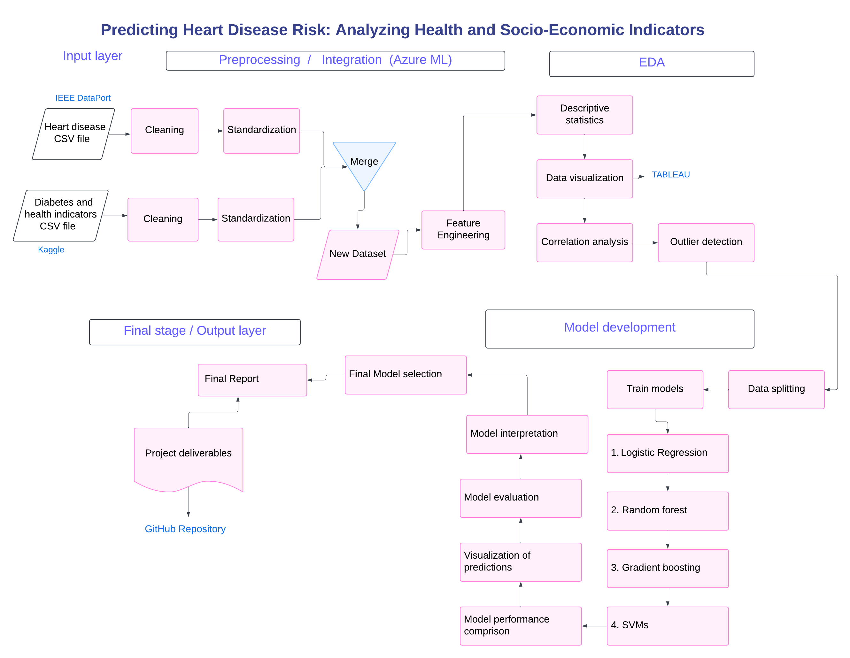
High - Level Architecture diagram

Slide 13

Thank you

